Slide 1

Learning SQL from Scratch
Attribution Queries
Joseph Barcia
10/17/18

Slide 2

Task 1

Slide 3

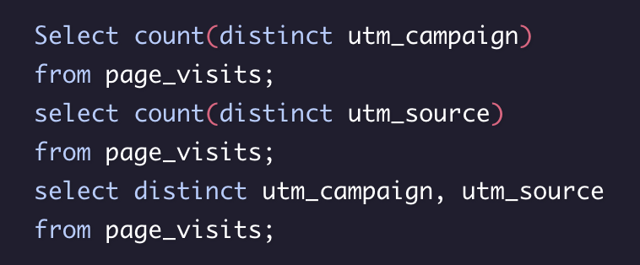
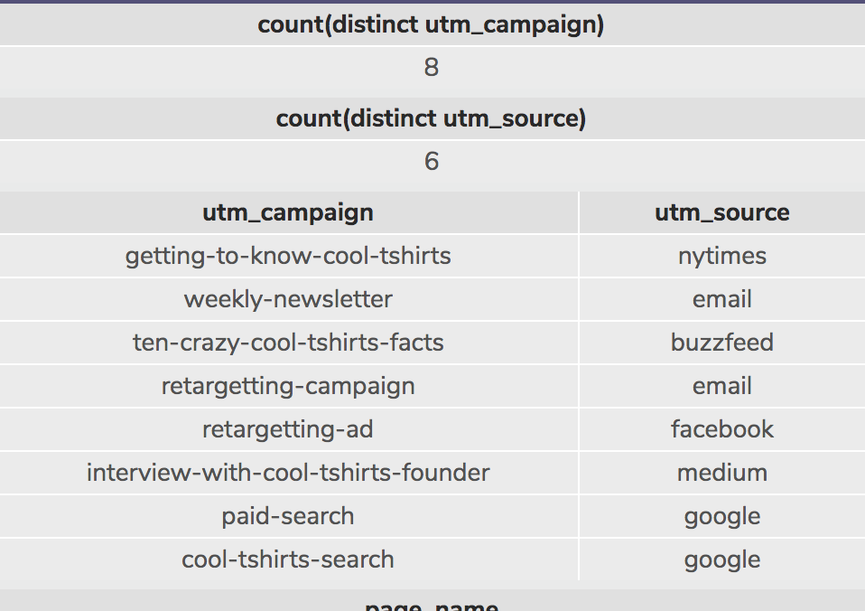
First we were looking to select the count of unique campaigns within the Page visits table.
Answer: 8
We then wanted to find how many unique sources we had within the page visits table.
Answer: 6
After discovering the total amount of unique campaigns and sources we wanted to see which campaigns aligned with each source.
As a result;
The getting-to-know-cool-tshirts campaign was found on the nytimes
The weekly-newsletter and retargeting-campaign were both sent via email
Ten-crazy-cool-tshirts-facts was a blog on buzzfeed
There was a retargeting-ad on facebook
The interview-with-cool-tshirts-founder on medium
There were also marketing tactics for paid-search and cool-tshirts-search on google

Slide 4
Task 2

Slide 5


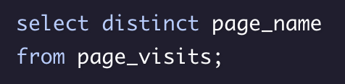
What pages are on the website?

Slide 6
Task 3

Slide 7

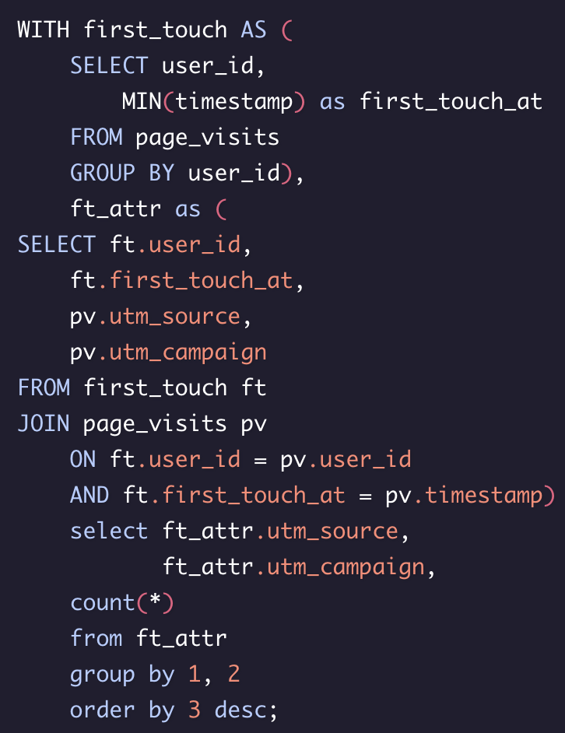
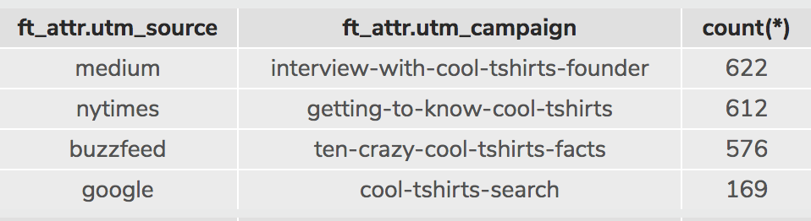
In order to find how many first touches each campaign is responsible for you need to fun the code on the left. The medium has the most first touches with 622. In a close second the NY times article “Getting to know cool tshirts” with 612 first touches. The buzzfeed article “Ten crazy cool tshirts facts” was third with 576 first touches. The google searches for cool tshirts came in last with 169

Slide 8
Task 4

Slide 9

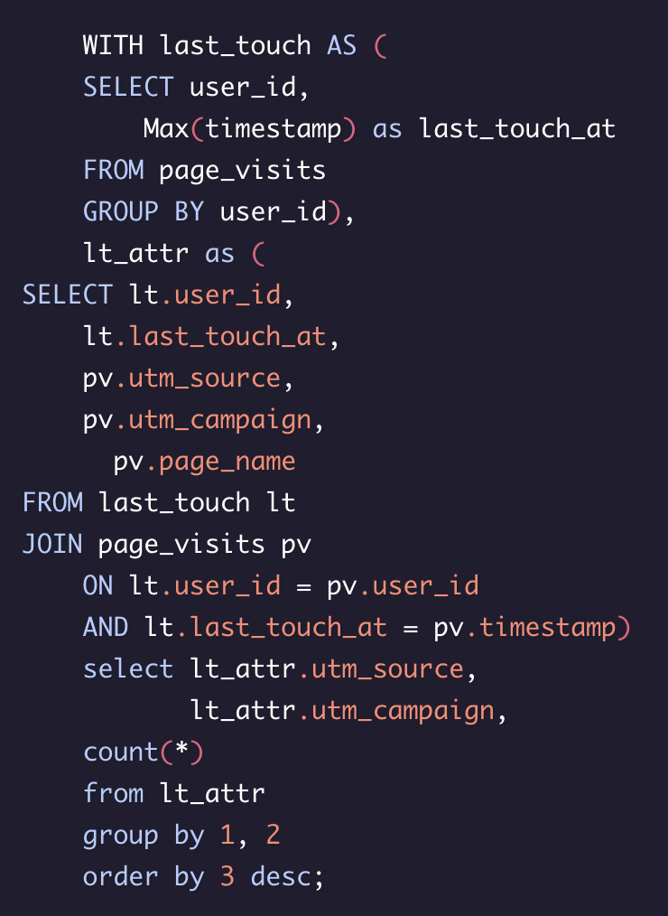
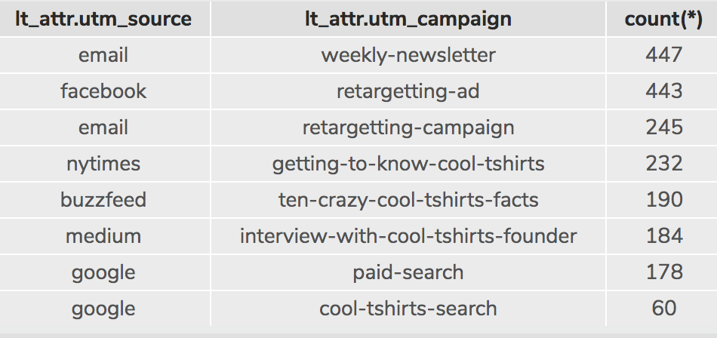
The email sources accounted for a majority of the last touches with a total of 629 from a combination of the weekly-newsletter and the retargeting-campaign.
The Facebook retargeting ad came in second with 443.
These were a clearly used to re-engage the customers meanwhile the other campaigns were used as a first touch strategy.

Slide 10
Task 5

Slide 11

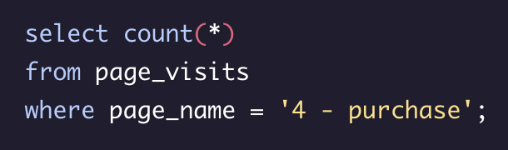

How many people purchased?
An easy way to find out who purchased was to find who was on the page “4 – purchase”

Slide 12
Task 6

Slide 13

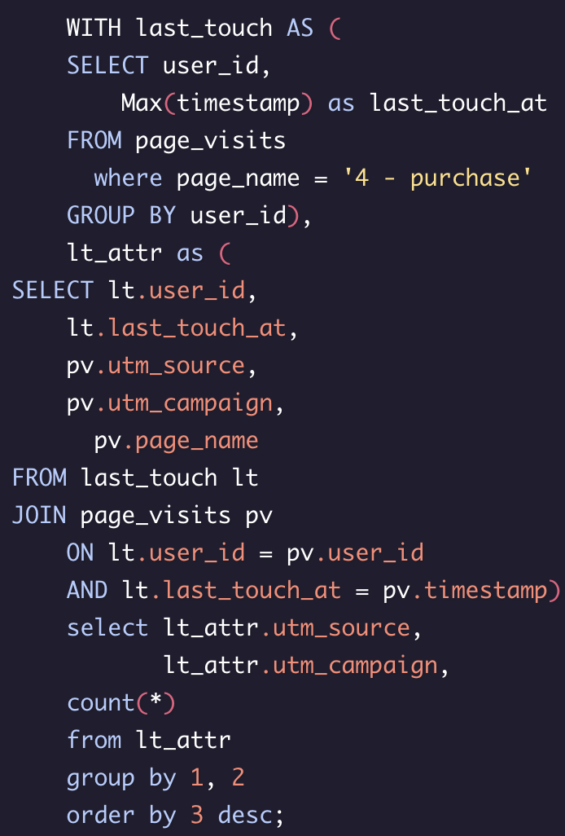
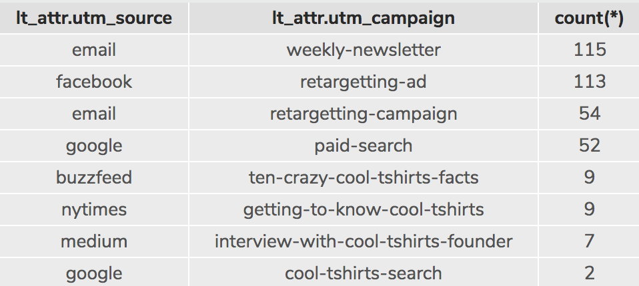
Looking at the last touches on the purchase page and as before the email campaigns are one the top of the list.
Facebooks retargeting ad is also at the top of the list as well with 113.
Google search also had decent results with 52 purchases.
The buzzfeed, ny times, medium and cool tshirts search on google all had a bad closing rate, not one broke into double digit numbers.

Slide 14

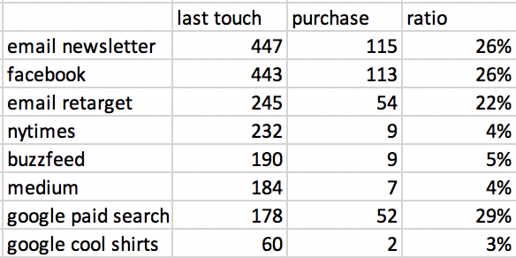
As you can see, for the sole purpose of last-touch attribution we have some campaigns that are working and some that need to be cut back
The most effective campaign is the google paid search. There should be much more investment into this along with both the email newsletter and email retargeting campaign as well as the facebook retargeting ad.
It would be beneficial to cut back on the buzzfeed, medium and nytimes spending

